Slide 1

Super-Resolution Reconstruction for Ray Tracing Images
報告人：洪宗邑、蕭英祐
指導教授：翁世光
影片介紹
https://www.youtube.com/watch?v=LH5OBCjm8VA

Slide 2
Outline
Introduce super-resolution
Interpolation
Linear
Cubic
Lagrange
Result and analysis for interpolation
EDSR
Result and analysis for EDSR
Conclusion

Slide 3

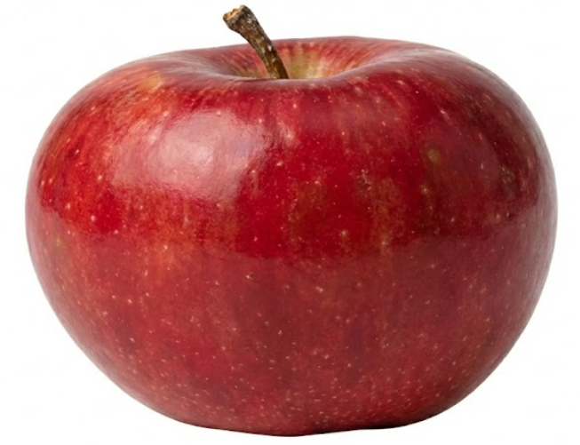
Introduction
What is super-resolution(SR)?
SR aims to reconstruct a higher resolution image from lower resolution images
We use SR because of high computation time needed for high quality ray tracing images
We can produce a low quality ray tracing image, then use SR procedure to quickly upscale it with details

Slide 4
Introduction
E
E
Reconstruction approach
Use multiple low resolution images
Registration
Recover the image by different math method
Example-based approach
Convolution neural networks architecture in most cases
Supervised learning
SRCNN, SRGAN, ESPCN
Notes:
Registration:將這多個影像中的對應點映射到原始場景中的實際點，並將資料轉換到同一座標系中，
如圖，他可以有個planar surface的基準的image，那其他的image就按照角度按每個點會對應到哪裡，然後眼睛是在影像中心 Math model:可能做傅立葉轉換、內插

Slide 5
























Mapping two image
Assume there are 4 points that need to be resampled to 8 points.
$$X_{0}$$
$$X_{1}$$
$$X_{2}$$
$$X_{3}$$
$$X_{0}^{′}$$
$$X_{1}^{′}$$
$$X_{2}^{′}$$
$$X_{3}^{′}$$
$$X_{4}^{′}$$
$$X_{5}^{′}$$
$$X_{6}^{′}$$
$$X_{7}^{′}$$
$$X_{0}$$
$$X_{1}$$
$$X_{2}$$
$$X_{3}$$
$$X_{0}^{′}$$
$$X_{1}^{′}$$
$$X_{2}^{′}$$
$$X_{3}^{′}$$
$$X_{4}^{′}$$
$$X_{5}^{′}$$
$$X_{6}^{′}$$
$$X_{7}^{′}$$
Notes:
對應主要用上面
下面是分固定區塊

Slide 6
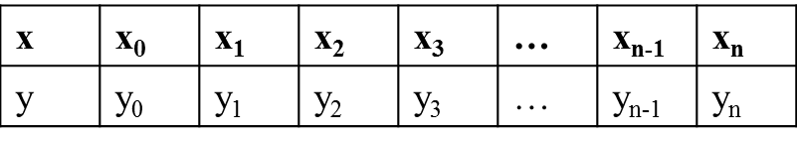

Linear Interpolation
The graph
Problem: Given two samples (a, f(a)) and (b, f(b)), compute f(t), where $a<b, t∈\left[a,b\right].$
Linear interpolation:
$f\left(t\right)=f\left(a\right)+\frac{f\left(b\right)−f\left(a\right)}{b−a}(t−a)$
Piecewise Linear Interpolation
a
t
b
The input data:
The piecewise linear interpolation function s(x) consists of n linear polynomials.
x₀
x_{n}
x_{i}
x_{i+1}
Notes:
這之前其實還有個nearest neighbor 但是很明顯出來的圖不會平滑

Slide 7
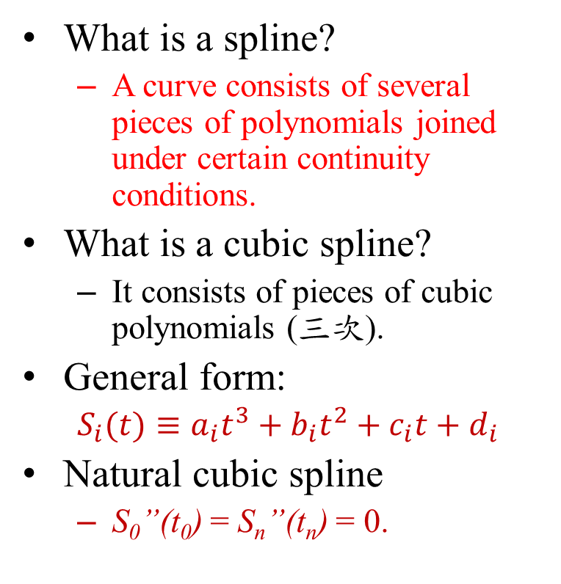
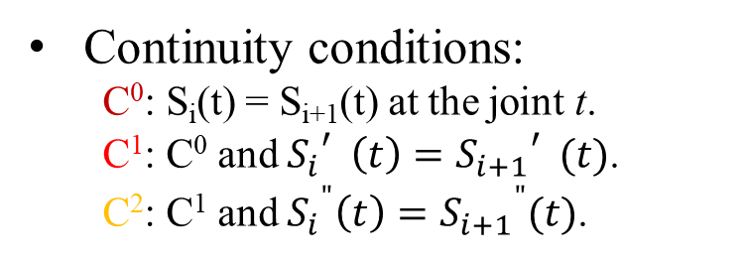
Natural Cubic Splines
What is a spline?
A curve consists of several pieces of polynomials joined under certain continuity conditions.
What is a cubic spline?
It consists of pieces of cubic polynomials (三次).
General form:
$S_{i}(t)≡a_{i}t^{3}+b_{i}{t^{2}+c}_{i}t+d_{i}$
Natural cubic spline
S₀”(t₀) = S_{n}”(t_{n}) = 0.
A spline of 3 pieces.
S₁(t)
S₀(t)
S₂(t)
t₀
t₁
t₂
t₃
Continuity conditions:
C⁰: S_{i}(t) = S_{i+1}(t) at the joint t.
C¹: C⁰ and ${S_{i}}_{}^{′}\left(t\right)={S_{i+1}}_{}^{′}(t)$.
C²: C¹ and ${S_{i}}^{"}\left(t\right)={S_{i+1}}^{"}(t)$.
Notes:
三次通常效果最好，不過過度複雜也夠平滑

Slide 8
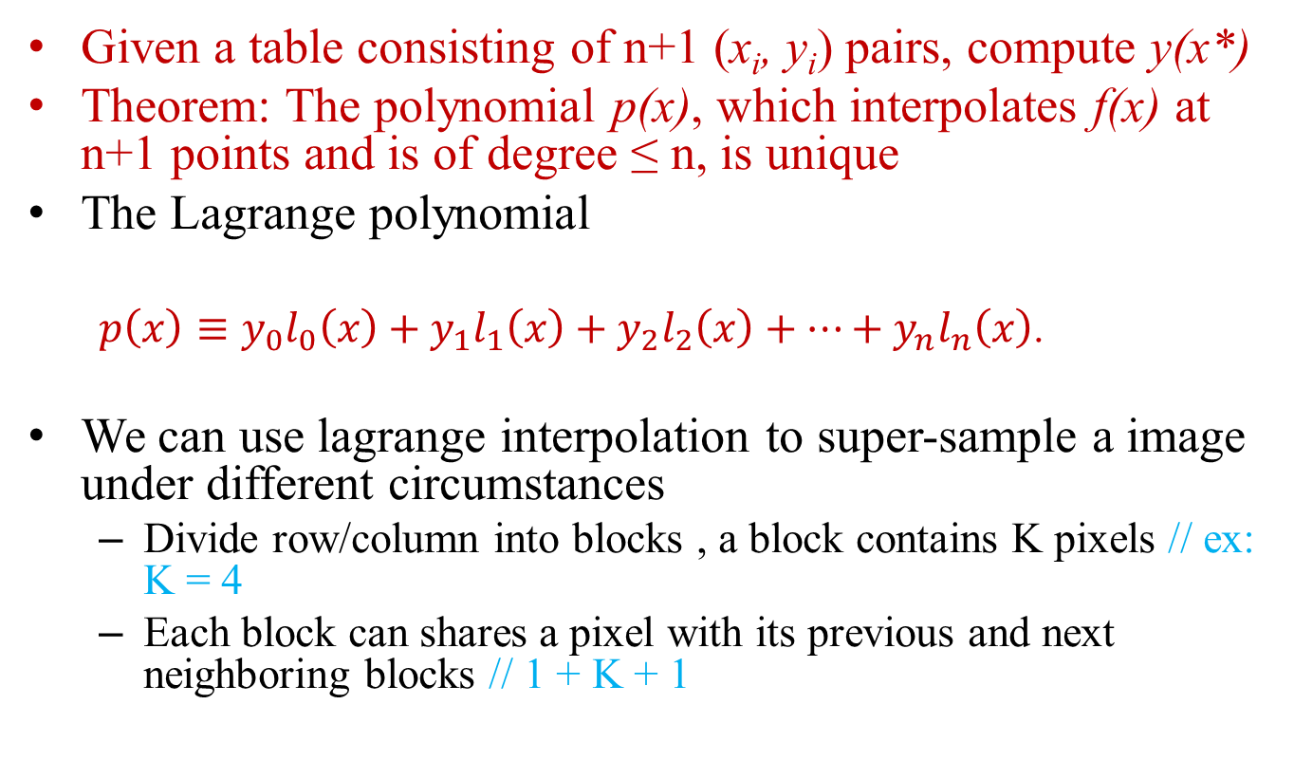
Lagrange interpolation
Given a table consisting of n+1 (x_{i}, y_{i}) pairs, compute y(x*)
Theorem: The polynomial p(x), which interpolates f(x) at n+1 points and is of degree ≤ n, is unique
The Lagrange polynomial
$p\left(x\right)≡y_{0}l_{0}\left(x\right)+y_{1}l_{1}\left(x\right)+y_{2}l_{2}\left(x\right)+…+y_{n}l_{n}\left(x\right)$.
We can use lagrange interpolation to super-sample a image under different circumstances
Divide row/column into blocks , a block contains K pixels // ex: K = 4
Each block can shares a pixel with its previous and next neighboring blocks // 1 + K + 1

Slide 9

Evaluation metrics
PSNR
Based on pixel difference (MSE)
${MAX}_{I}:$ Maximum pixel value
e.g., 255 for 8-bit
Higher value = Better quality
(Unit: dB)
SSIM
Based on human visual perception
Luminance, Contrast, and Structure
Range: 0 to 1
(Closer to 1 is Better)

Slide 10

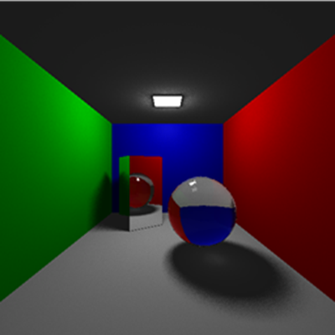
Original RGB image
Resolution:64x64
Resolution:256x256

Slide 11
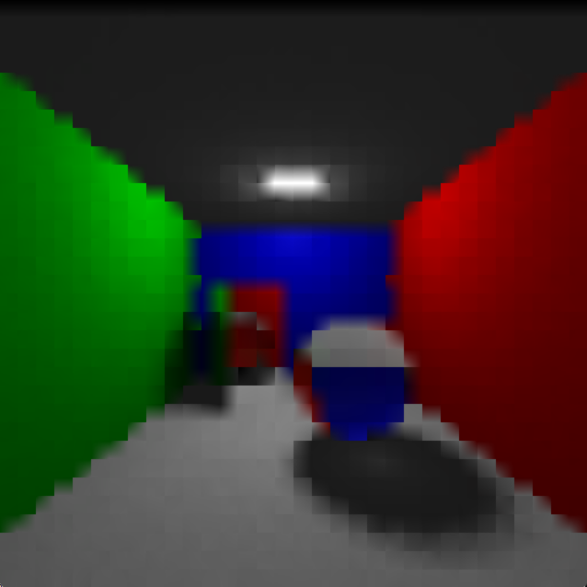
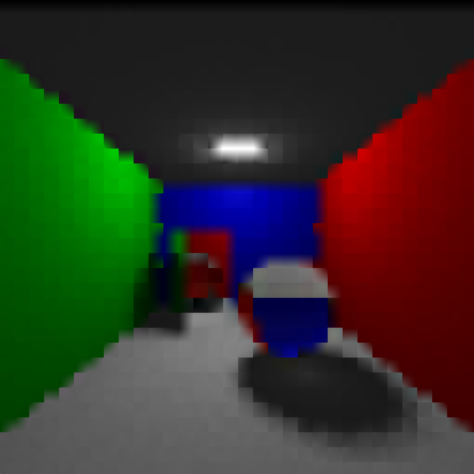


Result
Lagrange interpolation with block size = 2
K
1 + K + 1

Slide 12
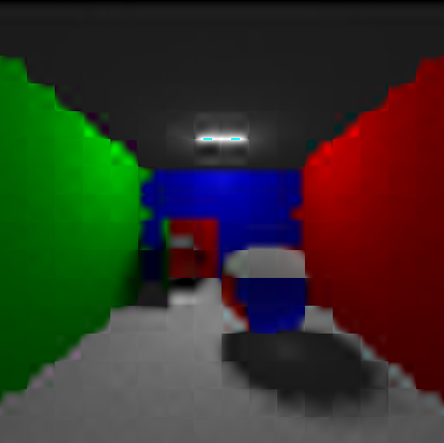



Result
Lagrange interpolation with block size = 4
K
1 + K + 1

Slide 13
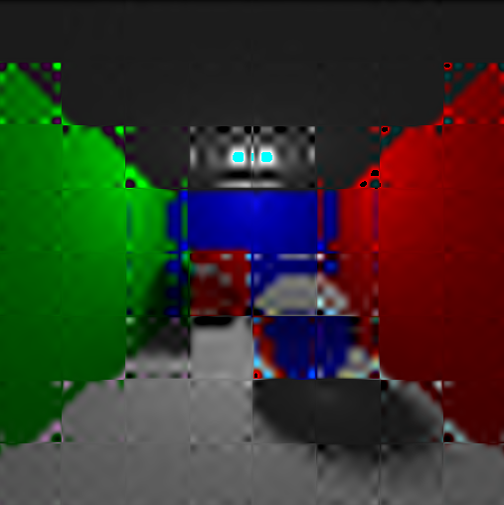
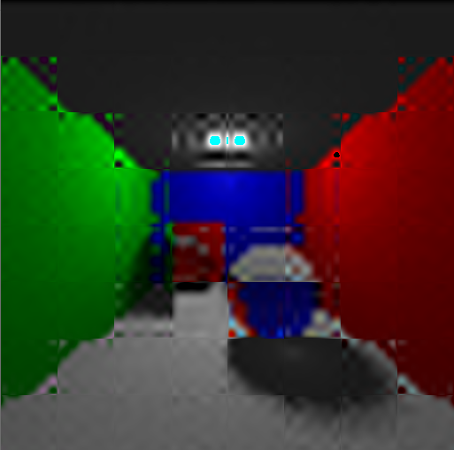


Result
Lagrange interpolation with block size = 8
K
1 + K + 1

Slide 14




Result
Lagrange interpolation with block size = 16
K
1 + K + 1

Slide 15
Analysis
Lagrange interpolation
K | 2 | 4 | 8 | 16
PSNR | 25.60 | 25.37 | 22.78 | 11.50
SSIM | 0.924995 | 0.923335 | 0.874765 | 0.402125
1+K+1 | 2 | 4 | 8 | 16
PSNR | 25.46 | 25.46 | 23.93 | 13.24
SSIM | 0.923615 | 0.924440 | 0.901377 | 0.501433

Slide 16
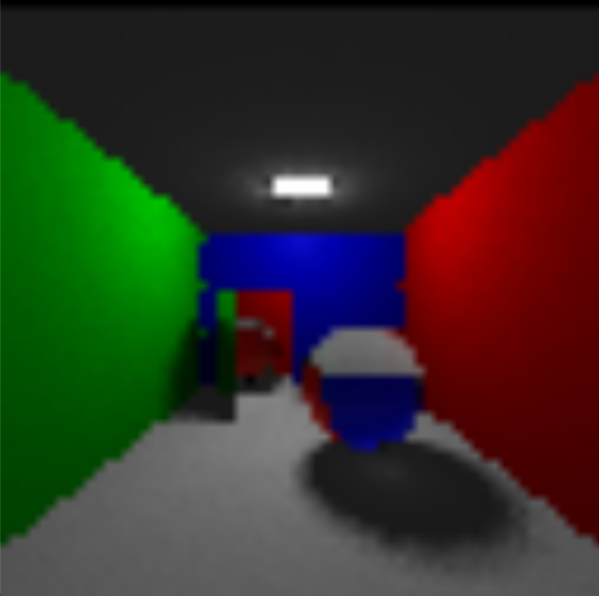

Result & Analysis
K | Bilinear | Bicubic
PSNR | 25.79 | 25.29
SSIM | 0.929455 | 0.923665
Linear
Cubic spline

Slide 17
Original RGB image
Resolution:64x64
Resolution:256x256

Slide 18
Outline
Introduction
Interpolation
Linear
Cubic
Lagrange
Result and analysis
EDSR

Slide 19
AI approach
Enhanced Deep Residual Networks for Single Image Super-Resolution
利用cnn加上最佳化過的殘差網路來做super resolution
提供了兩個模型，一個單尺度的EDSR和一個多尺度的MDSR
主要貢獻是對於ResNet 架構的更改使其更適合super resolution

Slide 20
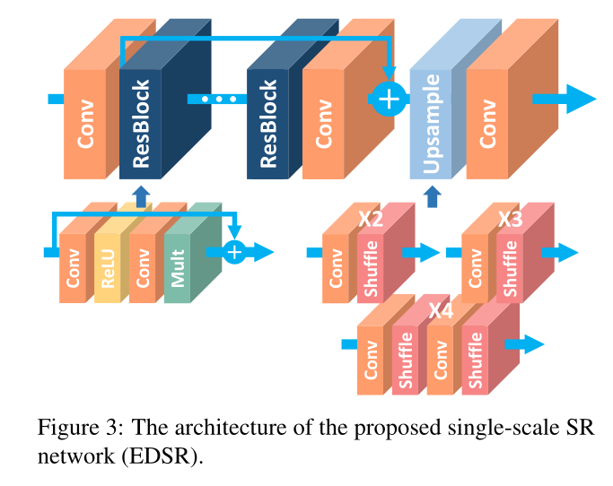
Modified EDSR
淺層特徵提取
ResBlock
上採樣模組
Sub-pixel Convolution
利用Edge loss
L1 loss加上邊緣特徵

Slide 21
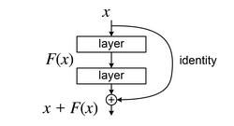
Residual Neural Network(ResNet)
目的
減輕深層網路訓練的難度
解決梯度消失和梯度爆炸
Residual Block
利用Shortcut Connection把原始輸入和輸出相加
學習輸入和輸出之間的殘差映射，而不是直接學習輸出

Slide 22
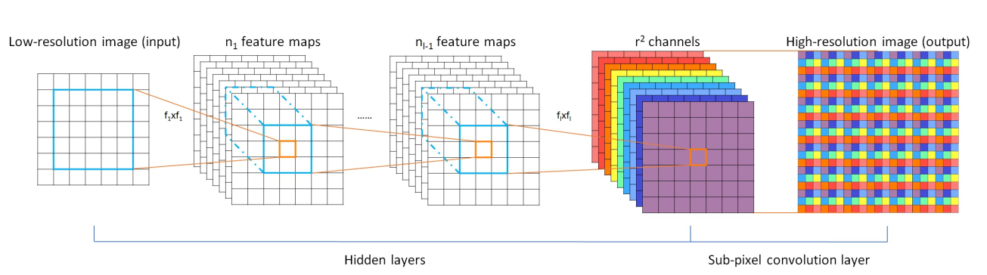
Upsample
sub-pixel convolution
透過重新排列pixel來獲得高解析度圖片

Slide 23

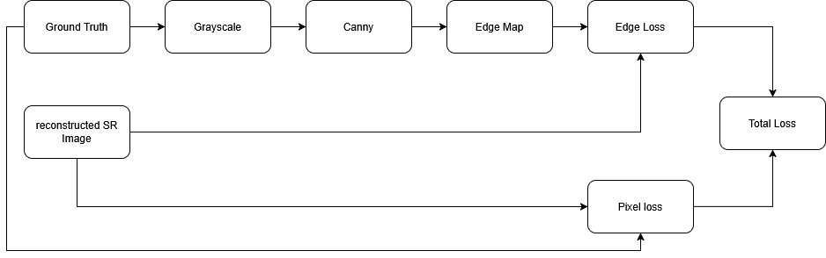
Loss function
Edge loss
光跡追蹤影像有清晰、銳利的幾何邊緣
利用邊緣損失函數加上L1損失函數來加強模型對物體邊緣的重建品質

Slide 24
Training parameter
模型架構參數
ResBlocks: 16
Features: 64
Kernel Size: 3×3
Scale: 4x
訓練策略參數
Epochs: 300
Batch Size: 4
Optimizer: Adam
實驗參數
Loss Function: L1 Loss、L2 Loss 、Edge Loss
Datasets: DIV2K 、光跡追蹤圖像

Slide 25

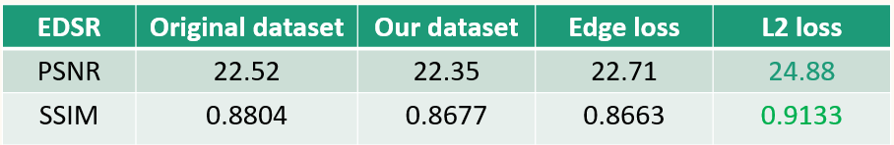
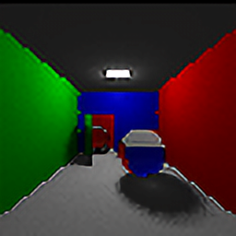
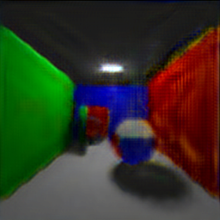
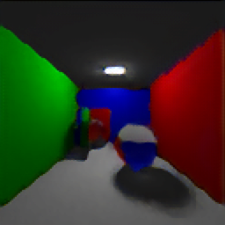
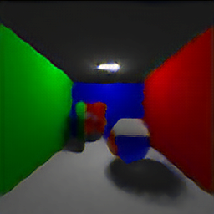
Result
LR
HR
DIV2K
L2 Loss
L1 Loss
Edge Loss

Slide 26
Conclusion
Traditional method is insufficient for ray tracing
But it served as a solid baseline for observation
Quantitative metrics (PSNR/SSIM) are not always reliable
Seeing is believing
EDSR is a feasible model
But need more improvements
Future work
Enrich datasets with different type of scenes
Implement other architectures for potential gains

